Slide 1


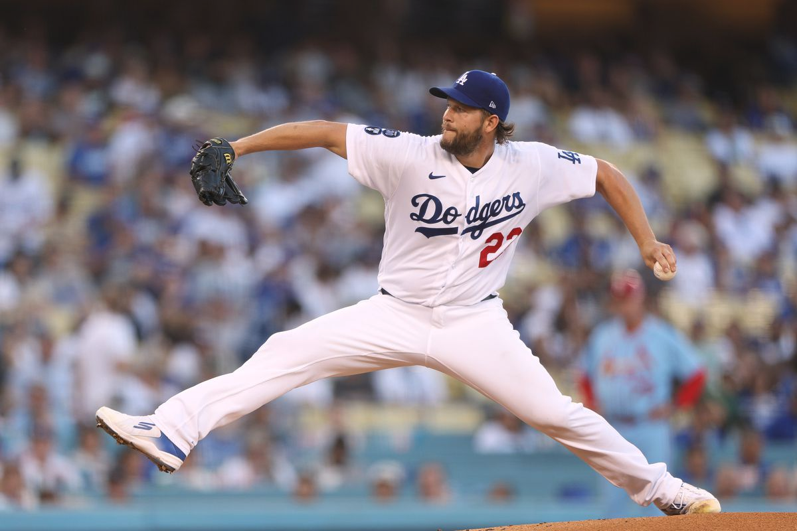
Fantasy Baseball Projections
Suhas Buravalla and Carter Rogers
DATS6501 - Data Science Capstone
.311 AVG, 62 HR, 131 RBI, 133 R, 16 SB
21 W, 1.77 ERA, 239 SO, 0.86 WHIP

Slide 2

Agenda
Background
Problem Statement
Our Data Set: Gathering, Preprocessing, Features & Targets
Modeling: Approach & Methodology
Results
Conclusion
Fantasy Baseball Projections - DATS6501

Slide 3

Background
Major League Baseball vs. Fantasy Baseball
“Moneyball”, advanced analytics
Statcast creating new wave of data in MLB
Using data to gain competitive edge, drive decision-making
How to measure and predict player performance?
Fantasy Baseball Projections - DATS6501

Slide 4

Background
Fantasy Baseball
Rotisserie 5x5 Standard Format
Real life player results dictate success of fantasy team
Using basic stats to measure performance
How to predict player performance?
Projection systems – ZiPS, Steamer, The BAT X
Limitations
Fantasy Baseball Projections - DATS6501

Slide 5

Problem Statement
Rotisserie 5x5 Scoring:
Hitters – Batting Average, Home Runs, Runs Batted In, Runs Scored, Stolen Bases
Pitchers – Wins, Earned Run Average, Strikeouts, Saves, Walks + Hits per Inning Pitched
Problem Statement: Develop a predictive model using real-world baseball data to project future fantasy baseball results
Fantasy Baseball Projections - DATS6501

